Slide 1
CS227 DIGITAL LAB MINI PROJECT SMART PARKING SYSTEM WITH GATE
BY
SHANTANU PUNDE
2101MC53

Slide 2
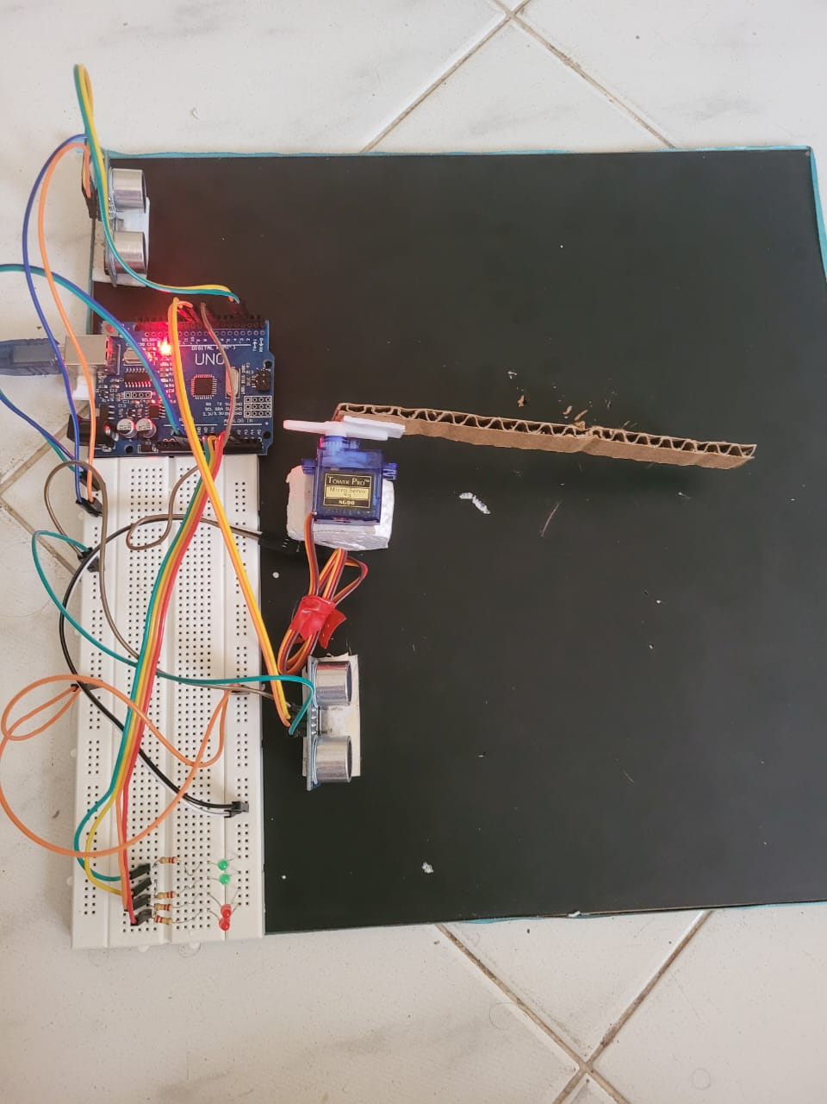
PROJECT DESCRIPTION
In this project, we create a smart parking system, in which a sensor detects whether a vehicle is approaching the parking slot or not. When the sensor detects the vehicle, it opens the gate for the vehicle to enter the parking slot. Further, there is a sensor at the back wall of every parking slot, that detects the distance of the vehicle from the wall. As the vehicle approaches the wall, and as the distance between the vehicle and the wall decreases, each of the 4 LED lights attached on the wall start lighting up. As the distance decreases, the number of LED light lighting up increases, from 1 to 4. When the vehicle is perfectly parked at a right distance from the wall, all the 4 LEDs light up showing that the vehicle is parked successfully, and the driver’s work is done.

Slide 3
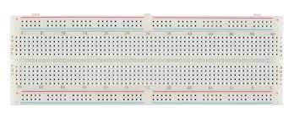
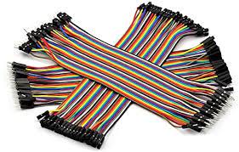
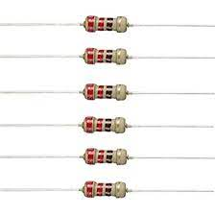
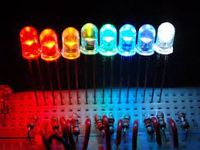
ELECTRIC COMPONENTS USED
Breadboard (WB-102 840 points)
Arduino UNO SMD Board
Jumper Wires (M to F, M to M, F to F)
Resistors (220KΩ)
LEDs (Green and Red)
HC-SR04 Ultrasonic Sensor
SG90 Positional Servo Motor
9V Battery
9V Battery Snap Connector

Slide 4
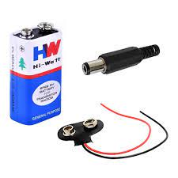
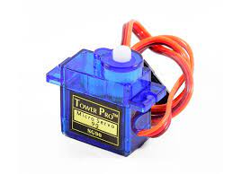
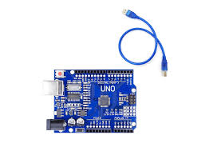
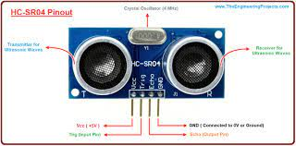

Slide 5
WORKING PRINCIPLE
We start by understanding the mechanism of the entrance gate of the Smart Parking System. The arm of the gate is attached to the SG90 servo motor. The servo motor is controlled by a HC-SR04 ultrasonic server. When the vehicle, comes in the prescribed distance range of the ultrasonic sensor, the sensor detects the presence of the vehicle and according the function in Arduino, it controls the servo motor SG90 to rotate by 90 degrees, and hence open the gate for the vehicle to enter the parking slot.
After the gate is open, the vehicle can enter the parking slot. The gate remains open for 7 seconds for the vehicle to pass. After crossing the gate, the vehicle enters the parking area. Here, initially all the LEDs on the wall are OFF. As the vehicle approaches the wall, the HC-SR04 ultrasonic sensor calculates the distance between itself(the wall) and the vehicle, and controls the 4 LEDs. As the distance decreases, the 4 LEDs start lighting up.
The entire circuit is powered by a 9V battery which is connected to the Arduino UNO board via the 9V battery snap connector.

Slide 6
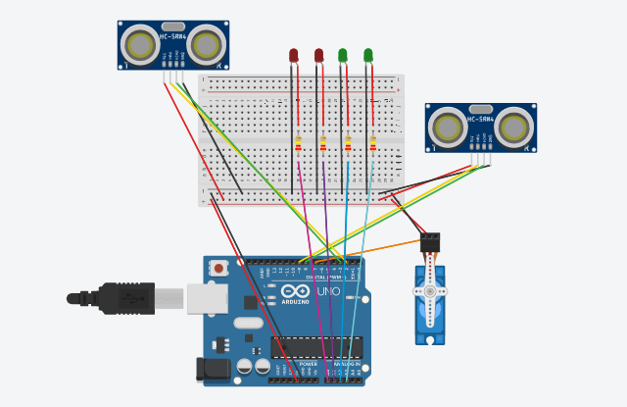
CIRCUIT DIAGRAMS

Slide 7
PIN CONNECTIONS
Servo Motor : PWM = pin 7;
Ultrasonic sensor that controls the toll gate : Trigpin = pin 9;
Echopin = pin 8;
Ultrasonic sensor that controls the indicator LEDs : Trigpin = pin 2;
Echopin = pin 3;
Vcc (Power) to 5V pin;
Ground to GND pin;
LED 1 = pin A0;
LED 2 = pin A1;
LED 3 = pin A2;
LED 4 = pin A3;

Slide 8
CODE FOR THE CIRCUIT
#include<Servo.h>
const int servotrig = 9;
const int servoecho = 8;
const int trigPin = 2;
const int echoPin = 3;
int distance=0;
int duration=0;
const int LED1 = A0;
const int LED2 = A1;
const int LED3 = A2;
const int LED4 = A3;
Servo gate;

Slide 9
void setup() {
Serial.begin(9600);
pinMode(servotrig, OUTPUT);
pinMode(servoecho, INPUT);
gate.attach(7);
}
void loop() {
digitalWrite(servotrig,LOW);
delayMicroseconds(2);
digitalWrite(servotrig,HIGH);
delayMicroseconds(10);
digitalWrite(servotrig,LOW);
long t =pulseIn(servoecho,HIGH);
long cm = t /29 / 2;
gate.write(170);

Slide 10
if (cm<= 19){
for( int j=170;j>=80;j--){
gate.write(j);
delay(20);
}
delay(2500);
for( int i=80;i<=170;i++){
gate.write(i);
delay(20);
}
}
else{
gate.write(170);
} digitalWrite(trigPin, LOW);
delayMicroseconds(2);
digitalWrite(trigPin, HIGH);
delayMicroseconds(10);
digitalWrite(trigPin, LOW);
duration = pulseIn(echoPin, HIGH);

Slide 11
distance = duration/58.2;
if ( distance <= 5 )
{
digitalWrite(LED1, HIGH);
}
else{
digitalWrite(LED1, LOW);
}
if ( distance <= 8 )
{
digitalWrite(LED2, HIGH);
}
else{
digitalWrite(LED2, LOW);
}
if ( distance <= 11 )
{
digitalWrite(LED3, HIGH);
}
else{
digitalWrite(LED3, LOW);
}

Slide 12
if ( distance <= 14 )
{
digitalWrite(LED4, HIGH);
}
else{
digitalWrite(LED4, LOW);
}
delay(100);
}

Slide 13
THANK YOU !

